Slide 1
Illumination Models and Surface Rendering Methods
Realistic displays of a scene are obtained by perspective projection and applying natural light effects to the visible surfaces
an illumination model (lighting model) or shading model, is used to calculate the intensity of light that we should see at a given point on the surface of an object.
A surface rendering algorithm uses the intensity calculations from an illumination model to determine the light intensity calculation from an illumination model.

Slide 2
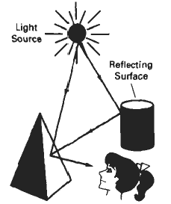
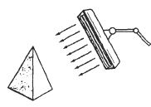

^{Light Sources}
Point source: tungsten filament bulb image can be seen
Distributed light source: fluorescent light
When light is incident on an opaque surface part reflected part
absorbed. Surface that are rough or grainy tend to scatter
reflected light in all direction is called diffuse reflection
Light sources create highlights or bright spots called specular-reflection.

Slide 3
^{Ambient light}
Ambient light surface directly not exposed directly but visible if nearby objects are illuminated
Combination of light reflections from various surfaces to produce a uniform illumination called the ambient light or background light(no shadow’s produced)
It has no spatial or direction characteristics and amount on each object is a constant for all surfaces and over all directions
^{I}_{am} ^{= k}_{a} ^{. I}_{a}

Slide 4

^{Diffuse Reflections}
Ambient light is an approximation of global diffuse, light effects .
Diffuse reflections are constant over each surface in a scene independent of viewing direction
^{k}_{d} or diffuse reflection coefficient or diffuse reflectivity (0 to 1)
^{k}_{d} is nearly 1 for highly reflective surface and k_{d} is 0 where light absorbs (black surfaces)
Diffuse reflection intensity at any point on the surface as
^{I}_{ambDiff} ^{= k}_{d} ^{. I}_{d}
^{Where I}_{ambDiff} is ambient light due to diffusion and Id is light due to diffusion
assuming diffuse reflections from the surface are scattered with equal intensity
in all directions independent of the

Slide 5
^{Diffuse Reflections}
Viewing direction (called “ideal diffuse reflectors”) also called Lambertian
reflectors and governed by Lambert’s Cosine Law.
If “angle of incidence” between incoming light direction and surface normal is 0
^{I}_{LDiff} ^{= k}_{d} ^{. I} _{L} ^{Cos Ө}
^{where I}_{LDiff} ^{is light due to diffusion}
If N is unit normal vector to a surface and L is unit direction vector to the point light source then
^{I}_{LDiff} ^{= k}_{d} ^{. I} _{L} ^{(N . L)}
In addition many graphics packages introduce an ambient reflection coefficient k_{d} to modify ambient light intensity k_{d}
then I_{Diff}(i.e. total) = ka . Ia + kd . I L (N . L)

Slide 6
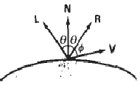
Specular Reflection/Phong Model
When we look at an illuminated shiny surface, such as polished metal, an apple etc we see a highlight or bright spot , at certain viewing direction this phenomenon is called “specular reflection” and is the result of total or near total reflection of the incident light in a concentrated region around the “specular reflection angle”.
This angle is equal to the angle of incidence.
^{N – unit normal surface vector}
R – unit vector in the direction
^{of ideal specular reflection}
L – unit vector directed towards
^{point light source}
V – unit vector pointing to viewer
^{from the surface position}
^{Ø – viewing angle relative to}
specular reflection direction R

Slide 7
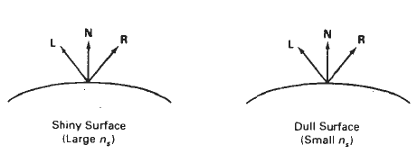
Specular Reflection/Phong Model
For ideal reflector (perfect mirror) incident light is reflected only in the specular reflection direction i.e. V and R coincide (Ø = 0 ).
Shiny surfaces have narrow Ø and dull surfaces have wider Ø
An empirical model for calculating specular reflection range was developed by Phong Bui Tuong called “Phong specular reflection” model and it sets the intensity of specular reflection directly proportional to
^{Cos ns Ø Ø → 0 to 90}
Specular reflection parameter n_{s} is determined by type of surface
Very shiny surface has large n_{s} ^{value}
Very dull surface has smaller n_{s} ^{value (down to 1)}
Rough surface, e.g. chalk has n_{s} ⁼ ¹

Slide 8
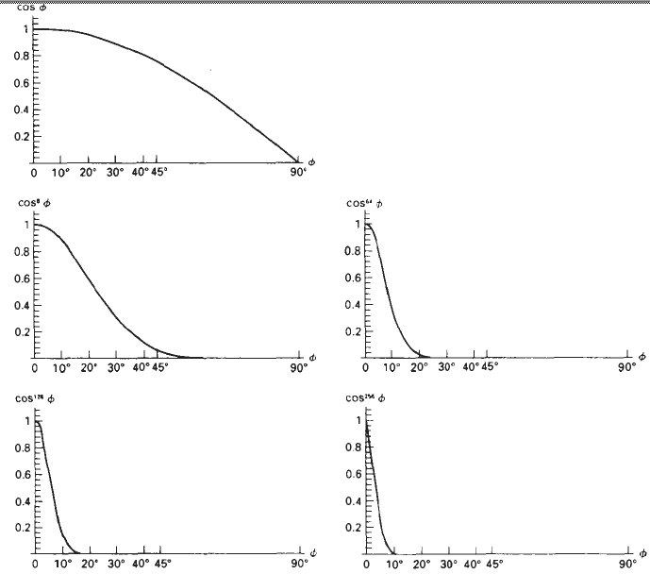
Specular Reflection/Phong Model
Intensity of specular reflection depends on material properties of surface, 0,other factors such as polarization , color of incident light.

Slide 9
Specular Reflection/Phong Model
For monochromatic specular reflections intensity variations can be approximated by SR coefficient W(Ө)
W(Ө) tends to increase as Ө increases, at Ө = 90 W(Ө) = 1 and all incident light is reflected.
Fresnal’s law of reflection describes specular reflection intensity with Ө and suing W(Ө), Phong specular reflection model as
^{I}_{spec} ^{= W(Ө) I}_{L} ^{Cosns Ø}
^{where I}_{L} ^{is intensity of light source}
Ø is viewing angle relative to the specular reflection direction R.
So transparent materials like glass exhibit specular reflection as 0 approaches 90. At 0 = 0 about 4 percent of the incident light on a glass surface is reflected.
Now also I_{spec} ^{= W(Ø ) I}_{L} ^{( V . R )}
^{as} ^{V . R = Cosns Ø}

Slide 10
Illumination Models and Surface Rendering Methods
Combined diffuse and specular reflections with multiple light sources
For single point light source
^{I = I}_{diffuse} ^{+ I}_{spec} ^{= K}_{a} ^{I}_{a} ⁺ ^{K}_{d} ^{I}_{L} ^{( N . L ) + K}_{s} ^{I}_{L} ^{( N . H ) ns}
For multiple light sources
^{I = K}_{a} ^{I}_{a} ⁺ _{Σ} ^{I}_{Li} ^{[ ( K}_{d} ^{( N . L}_{i} ^{) + K}_{s} ^{( N . H}_{i} ^{) ns ]}
^{i =1}

Slide 11
^{Assigning Intensity Levels}
To display n+1 successive intensity levels with equal perceived brightness the intensity levels on the monitor should be spaced so that ratio of successive intensities is constant.
^{I}₁ ^{/ I}₀ ⁼ ^{I}₂ ^{/ I}₁ = ------------------------------= I_{n} ^{/ I}_{n-1} ^{= r (0 < intensity < 1 )}
^{I}₀ = lowest intensity level and I_{n} ^{= highest intensity level}
any intermediate intensity in term of I₀ ^{I}_{k} ^{= r k I}₀ to calculate r substituting k = n and I_{k} ^{= I} _{n} ⁼ ¹
^{r = ( 1/I}₀ ^{)1/n}
^{e.g. if I}₀ = ⅛ and n = 3, r = 2 four intensities are ⅛ ¼ ½ and 1

Slide 12
^{Assigning Intensity Levels}
To display n+1 successive intensity levels with equal perceived brightness the intensity levels on the monitor should be spaced so that ratio of successive intensities is constant.
^{I}₁ ^{/ I}₀ ⁼ ^{I}₂ ^{/ I}₁ = ------------------------------= I_{n} ^{/ I}_{n-1} ^{= r (0 < intensity < 1 )}
^{I}₀ = lowest intensity level and I_{n} ^{= highest intensity level}
any intermediate intensity in term of I₀ ^{I}_{k} ^{= r k I}₀ to calculate r substituting k = n and I_{k} ^{= I} _{n} ⁼ ¹
^{1/n}
^{r = ( 1/I}₀ ⁾
^{e.g. if I}₀ = ⅛ and n = 3, r = 2 four intensities are ⅛ ¼ ½ and 1
^{Lowest intensity value I}₀ depends on the characteristics of the monitor
^{typically from 0.005 to 0.025}

Slide 13
Illumination Models and Surface Rendering Methods
For B.W. monitor with 8 bits per pixel (n = 255) and ^{I}₀ = 0.01 r = 1.0182 and approximate values for the 256 intensities on the system are 0.01, 0.0102, 0.0104,………., 0.98211, and 1.00.
For color, we setup intensity levels for each component of the color models ^{1/n}
Blue component of RGB I_{Bk} ^{= r}_{B}^{k I}_{B0} ^{where r}_{B} ⁼ ¹ ^{I}_{B0}

Slide 14
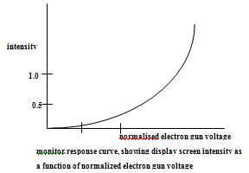
Gamma Correction and Video Look up Table
Problem associated with the display of calculated intensities is the non linearity of display devices and illumination model produce a linear range of intensities.
Usually calculated intensities are stored in an image file
as integer values (1 byte for each of three RGB components)

Slide 15
Gamma Correction and Video Look up Table
If we set the voltages for the electron gun to the linear pixel values the displayed intensities will be shifted according to the monitor response curve
To correct for monitor nonlinearity graphics systems use a video lookup table that adjusts the linear pixel values
Monitor response curve is described by the exponential function
^{γ}
I = a Vγ and V = I where, I = displayed Intensity, ^{a γ = input parameter}
a and γ depends on monitor characteristics
This calculation is referred to as “Gamma Correction of Intensity” ,
γ → 2 to 3 for NTSC γ = 2.2

Slide 16
^{Intensity Attenuation ( I A )}
Intensity is attenuated by the factor 1
d2 (d – distance that light has traveled)
Graphics package have a general inverse quadratic attenuation function
F(d) = 1
ª ₀ ^{+ a}₁ ^{d} ₁ ^{+ a}₂ ^{d} ₂
^{User can fiddle with a} ₀ ^{, a}₁ ^{, a}₂ to obtain a variety of lighting effects for a scene
Basic illumination model is modified as
^{n}
^{I = k}_{a .} ^{I}_{a} ^{+ ∑ f(d} _{i}^{) I} _{Li} ^{[ k}_{d} ^{(N . L}_{i}^{) + K}_{s} ^{( N . H}_{i} ^{) s ]}
^{i=1}

Slide 17
^{Transparency}
A transparent surface in general produces both reflected and transmitted light
^{Ө}_{r} ^{= angle of refraction n} _{r} ^{- index of refraction}
Ө _{i} = angle of incidence n _{i} - index of incidence
^{using Snell’s law}
Sin Ө_{r} = n _{r} Sin Ө _{I}
n _{I}
Also, I = (1 – k_{t})I_{reflect} + k_{t} I_{trans} ^{Where, I}_{trans} ^{is transmitted intensity}
^{I}_{reflct} ^{is reflected intensity}
^{k}_{t} ^{transparency coefficient}
^{(1 – k}_{t}^{) is the opacity factor}
For highly transparent object k_{t} ^{is near 1}
^{For opaque objects k}_{t} ^{is near 0}

Slide 18
A. Constant Intensity Shading
Fast and simple method for rendering of an object with polygon surfaces in CIS also called flat shading
Single intensity calculated for each polygon and useful for quickly displaying the general appearance of curved surface

Slide 19
This method is accurate if :
The object is a polyhedron and is not an approximation of an object with a curved surface
All light sources illuminating the object are sufficiently far from the surface
The viewing position is sufficiently far from the surface so that V.R is constant over the surface
Even if all conditions are not true, we can still reasonable approximate surface lighting effects using small polygon facets with flat shading and calculate the intensity for each facet at the center of the polygon.

Slide 20
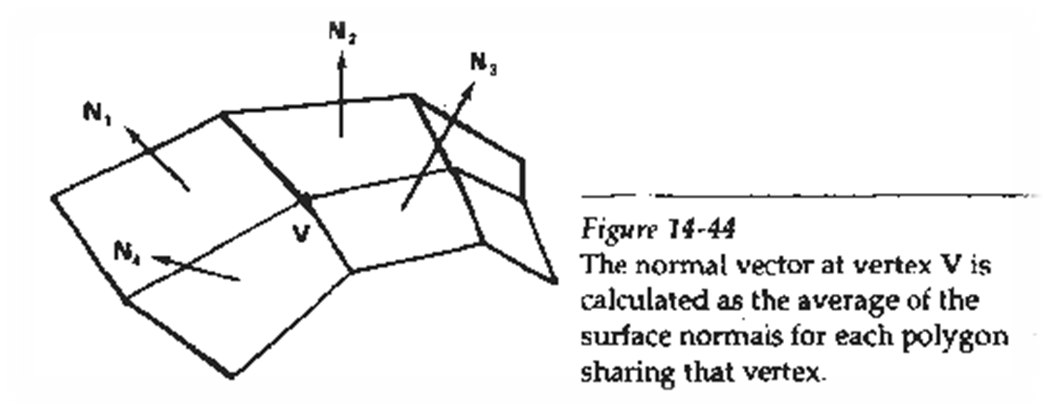
B. Gouraud Shading
This intensity interpolation scheme developed by Gouraud renders a polygon surface by linearly interpolating intensity values across the surface
Intensity values for each polygon are matched with the values of the adjacent polygon along the common edge thus eliminating the intensity discontinuities occur in “flat shading”

Slide 21
Calculation for each polygon surfaces
- Determine the average unit normal vector at each polygon vertex.
- Apply an illumination model to each vertex to calculate the vertex intensity
- Linearly interpolate the vertex intensities over the surface of the polygon
N₁ normal to ABCD plane , N₂ normal to CDEF plane and so on .

Slide 22
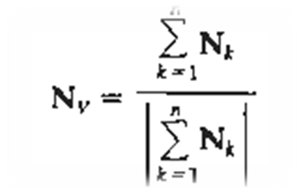
For any vertex position V normal unit vector once N_{v} is known intensity at vertices can be obtained from lighting model

Slide 23
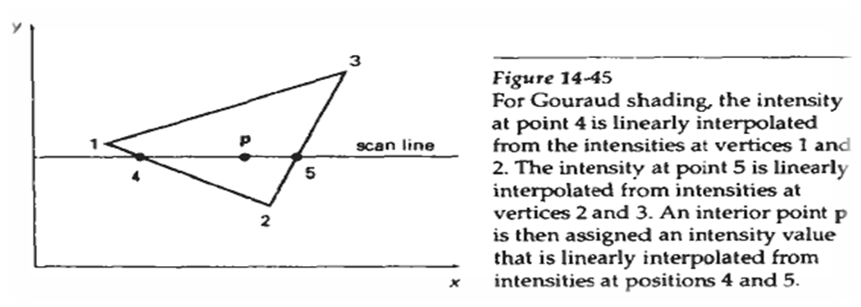
Next step:
Interpolating intensities along polygon edges
Fast method to find intensity at 4 using 1 and 2 using only vertical displacement
I₄ = y₄ - y₂ . I₁ + y₁ - y₄ . I₂ y₁ - y₂ y₁ - y₂
Similar process for I₅, using 3 and 2

Slide 24
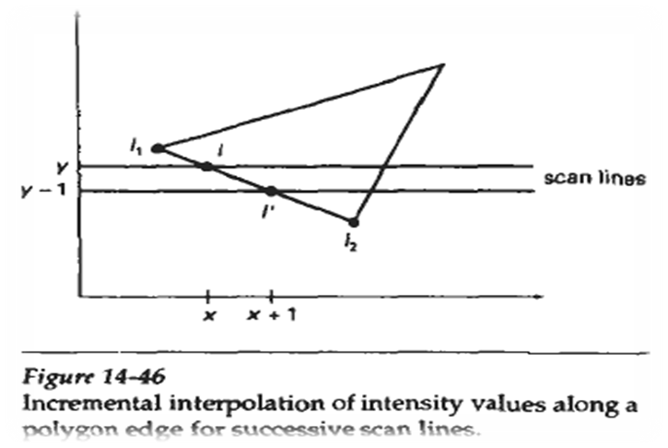

For interior point ‘p’ interpolated from the bounding intensities at point 4 & 5
I_{p} = x₅ - x_{p} . I₄ + x_{p} - x₄ . I₅ x₅ - x₄ x₅ - x₄
Easier than this is incremental calculations for successive edge intensity values
I = y - y₂ . I₁ + y₁ - y . I₂ y₁ - y₂ y₁ - y₂ for next scan line y - 1
I’ = I + I₂ – I₁ y₁ - y₂

Slide 25
Advantages:
- Removes discontinuities of intensity at the edge compared to constant shading model
Disadvantages:
- Highlights on the surface are sometimes displayed with anomalous shapes and linear intensity
- Interpolation can cause bright or dark intensity streak s called Mach Bands to appear on the surfaces.
Mach bands can be reduced by dividing the surface into a greater number of polygon faces or Phong shading(requires more calculation)

Slide 26
Phong Shading
More accurate method for rendering a polygon surface is to interpolate normal vector and then apply the illumination model to each surface point called “Phong Shading” or “Normal Vector Interpolation Shading”.
It displays more realistic highlights on a surface and greatly reduces Mach band effect.

Slide 27
Steps:
- Determine the average unit vector normal at each polygon vertex
- Linearly interpolate the vertex normal over polygon surface
- Apply an illumination model along each scan line to calculate projected pixel intensities for the surface points

Slide 28
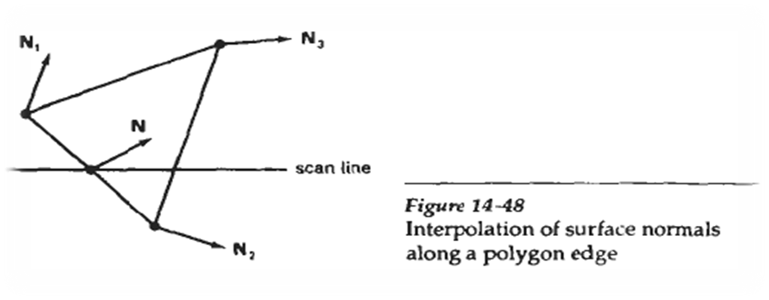
N can be obtained by vertically interpolating between edge end point normal (N₁ and N₂)
N = y - y₂ . N₁ + y₁ - y . N₂ y₁ - y₂ y₁ - y₂

Slide 29
Incremental methods are used to evaluate normal between scan lines and along each individual scan line (as in Gouraud) at each pixel position along a scan line the illumination model is applied to determine the surface intensity at that point
Produces accurate results than the direct interpolation but it requires considerable more calculations

Slide 30
Fast Phong Shading (FPS)
FPS approximates the intensity calculations using a Taylor series expansion and triangular surface patches
Surface normal at any point (x,y) over a triangle as N = Ax + By + C
A,B,C are determined from three vertex equations N_{k}= Ax_{k} + By_{k} + C …. k = 1,2,3 (x_{k},y_{k} vertex position)
Omitting reflexivity and attenuation parameters

Slide 31
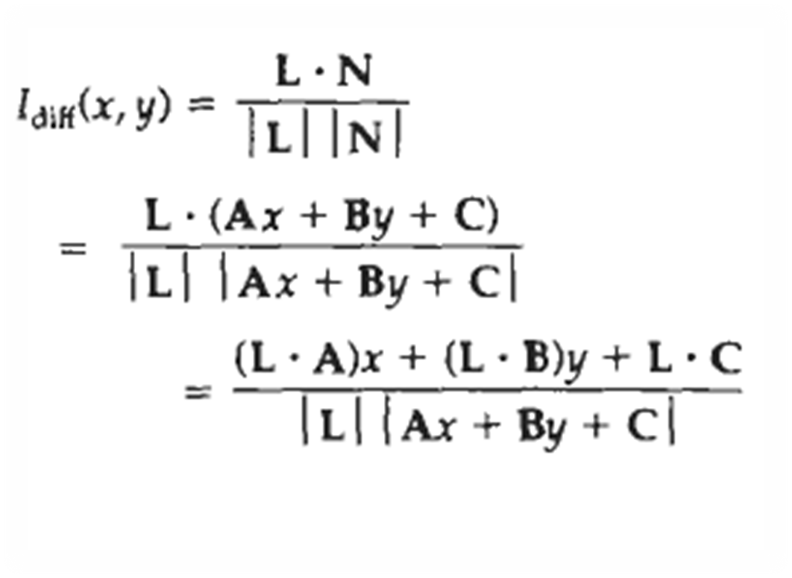

Slide 32
We can write
I_{diff} (x,y) = ax + by + c ………….(i)
(dx² + exy + fy² + gx + hy + i) ^{½}
Where a,b,c,d are used to represent the various dot products e.g. a = L . A
| L |

Slide 33
Finally denominator in eq(i) can be expressed as Taylor series expansion and retain terms up to second degree in x and y. This yields
I_{diff} (x,y) = T₅x² + T₄xy + T₃y² + T₂x + T₁y + T₀ ……………..(ii)

Slide 34
FPS is two times slower than Gouraoud shading
Normal Phong shading is 7 times slower than Gouraud
FPS can be extended to include specular reflections

Slide 35
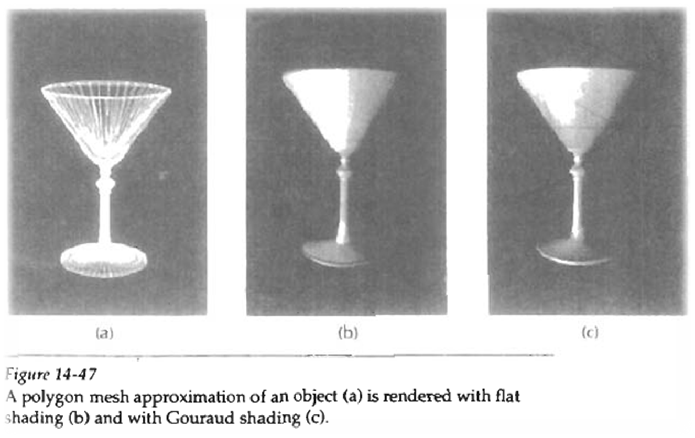

Slide 36
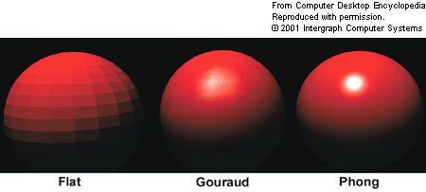

Slide 37
